Slide 1
Digital Portfolio
STUDENT NAME: E. GAYATHRI
REGISTER NO AND NMID:212400998/7C69FA267133B348F054B26B41C226D2
DEPARTMENT: COMPUTER APPLICATION
COLLEGE: COLLEGE/ UNIVERSITY OF MADRAS

Slide 2
PROJECT TITLE
DIGITAL PORTFOLIO

Slide 3


AGENDA
Problem Statement
Project Overview
End Users
Tools and Technologies
Portfolio design and Layout
Features and Functionality
Results and Screenshots
Conclusion
Github Link
3/21/2024 Annual Review

Slide 4

PROBLEM STATEMENT
Traditional resumes fail to fully showcase an individual’s skills, projects, and achievements in a dynamic way. Students and professionals often lack a structured platform to present their capabilities effectively. A digital portfolio solves this by providing an interactive and accessible space to highlight personal, academic, and professional accomplishments.

Slide 5
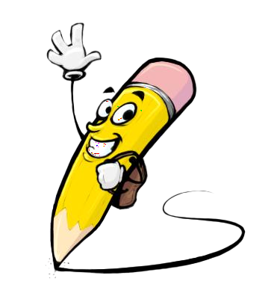
PROJECT OVERVIEW
This project is a digital portfolio created to present my academic background, skills, and achievements in a structured and professional format. It provides an easy way to showcase my growth as a student and my readiness for future opportunities.

Slide 6

WHO ARE THE END USERS?
Recruiters & Employers – to assess skills and projects for job opportunities. College Faculty & Evaluators – for academic assessment and project reviews. Peers & Collaborators – to share knowledge, ideas, and teamwork opportunities. General Audience – anyone interested in knowing about my skills and achievements.

Slide 7

TOOLS AND TECHNIQUES
This digital portfolio is developed using HTML, CSS, and Bootstrap to create a structured, visually appealing, and responsive design. Programming skills in C, C++, and Core Python are highlighted as part of the technical expertise. Simple design techniques like clean UI, easy navigation, and responsive layout have been applied to make the portfolio user-friendly and professional.

Slide 8
POTFOLIO DESIGN AND LAYOUT
The digital portfolio is designed with a clean and simple layout to ensure easy navigation and readability. It follows a structured format with dedicated sections such as About Me, Education, Skills, Projects, and Contact. The use of HTML, CSS, and Bootstrap ensures a responsive design that adapts to different screen sizes, making it accessible on both desktop and mobile devices. A minimal color scheme, clear fonts, and organized alignment have been applied to give the portfolio a professional and user-friendly appearance.
8

Slide 9
FEATURES AND FUNCTIONALITY
The digital portfolio provides a structured platform to showcase personal, academic, and professional details in an organized way. It features dedicated sections such as Project Overview, About Me, Education, Skills, and Contact, making information easily accessible to viewers. The use of responsive design ensures the portfolio works smoothly across devices, while a clean layout and simple navigation enhance the user experience. Overall, it functions as an interactive resume that highlights achievements, technical skills, and contact information in a professional manner.

Slide 10
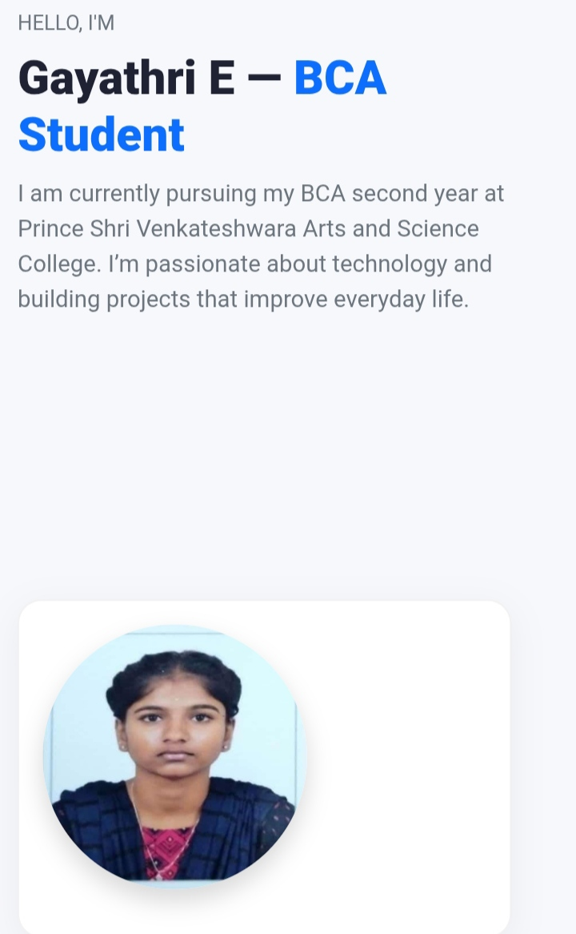

RESULTS AND SCREENSHOTS
3/21/2024 Annual Review
10

Slide 11
CONCLUSION The digital portfolio project successfully provides a structured and interactive platform to present my personal, academic, and technical details. It enhances visibility by showcasing skills, achievements, and contact information in a professional way. With its responsive design and user-friendly layout, the portfolio serves as an effective tool for self-presentation
11

Slide 12
GITHUB LINK https://egayathrijpg.github.io/MyprofileGayathri/

